Slide 1
Perception Analysis

Slide 2
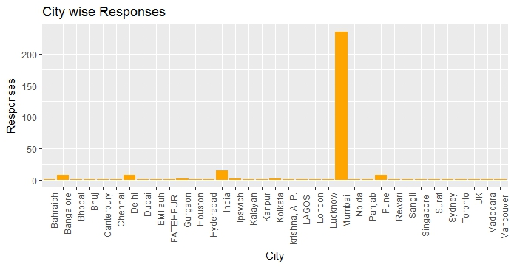
Cities | Responses
Mumbai | 235
Bangalore | 8
Delhi | 8
Pune | 8
Kolkata | 3
Maximum responses are from Mumbai City 235 out of 313 Responses

Slide 3
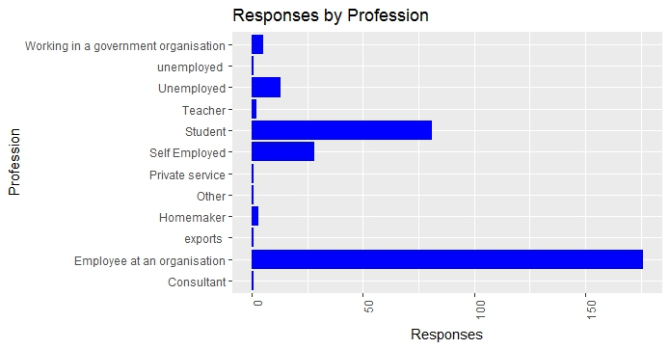
PROFESSION | RESPONSES
Salaried | 176
Student | 81
Self Emp. | 28
Un-Emp. | 13
Gov-Emp. | 5
Majority of respondent are Salaried(Employee at an organization)

Slide 4
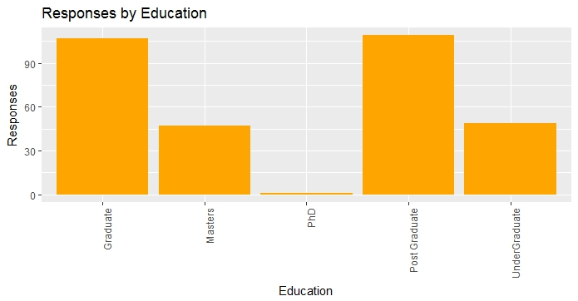
EDUCATION | RESPONSES
Graduate | 109
Post-Grad | 107
Under-Grad | 49
Masters | 47
PHD | 1
This variable shows Education of our respondents, most of them are graduate

Slide 5
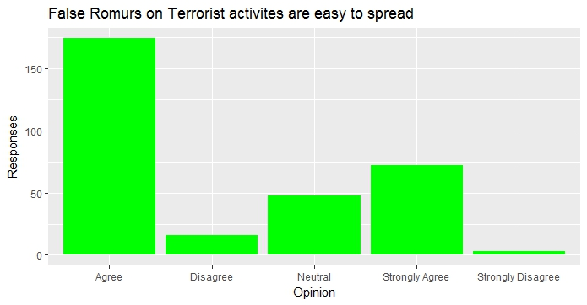
Do you think false rumors on terrorist activities are easy to spread?
Opinion | No of Res.
Strongly Agree | 72
Agree | 174
Neutral | 48
Disagree | 16
Strongly Disagree | 3
Maximum people are agree that false rumors on terrorist activities are easy to spread.

Slide 6
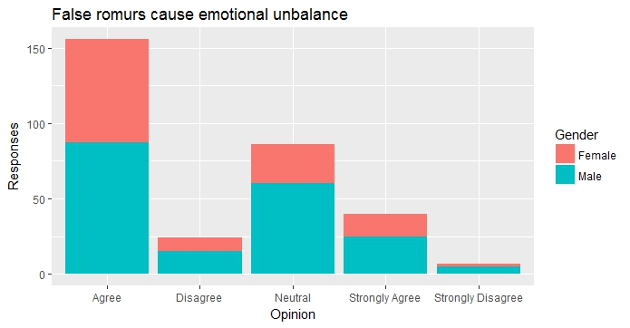
Does false rumors have sort of impact on you and cause emotional unbalance ?
Opinion | No of Res.
Strongly Agree | 40
Agree | 156
Neutral | 86
Disagree | 24
Strongly Disagree | 7
As per our observation false rumors cause emotional unbalance to the people

Slide 7
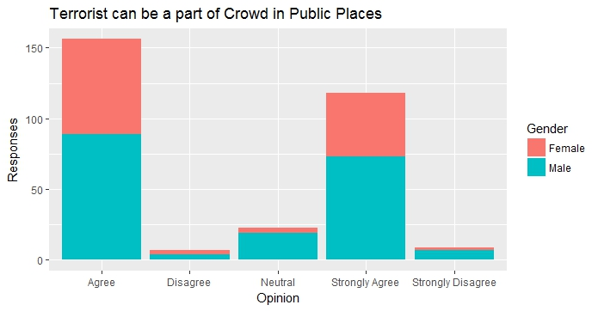
Can terrorist be a part of crowd resembling a common man in places likes shopping malls or public places ?
Opinion | No of Res.
Strongly Agree | 118
Agree | 156
Neutral | 23
Disagree | 7
Strongly Disagree | 9
People believe that terrorist can be the part of crowd which shows a kind of fear in their mind.

Slide 8
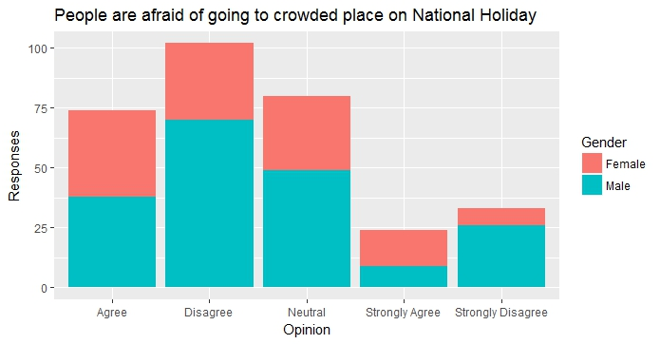
Are you afraid of going to a crowded place on a National Holiday or National Festival (being a part of mob)?
Opinion | No of Res.
Strongly Agree | 24
Agree | 74
Neutral | 80
Disagree | 102
Strongly Disagree | 33
As per responses we can observe that people are not afraid of going in crowded place on National Holidays or National Festivals

Slide 9
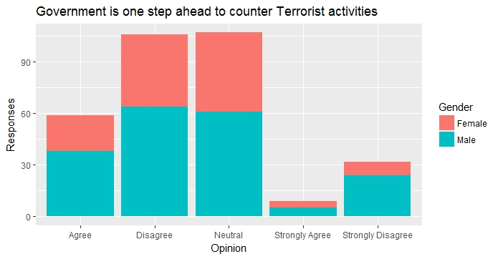
Do you think your Local Government is one step ahead to counter Terrorist activities?
Opinion | No of Res.
Strongly Agree | 9
Agree | 59
Neutral | 107
Disagree | 106
Strongly Disagree | 32
People are neutral on this but many of them think that government needs to be more vigilant to counter terrorist activities.

Slide 10
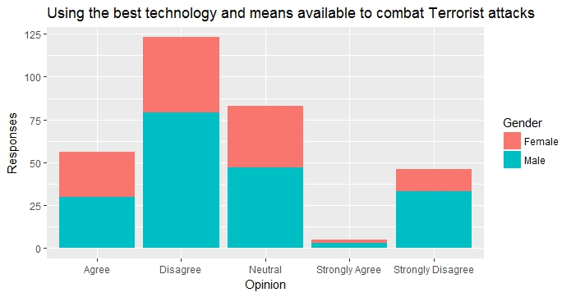
Do you think your City Police is using the best technology and means available to combat Terrorist attacks?
Opinion | No of Res.
Strongly Agree | 5
Agree | 56
Neutral | 83
Disagree | 123
Strongly Disagree | 45
Government needs to upgrade in terms of technology to combat terroristic attacks.

Slide 11
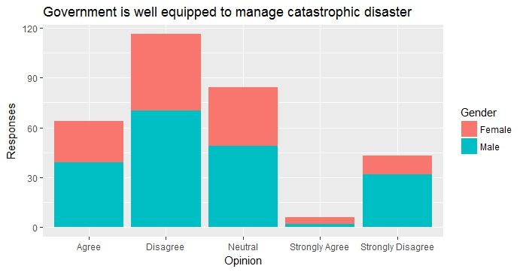
Do you think your Local Government is well equipped to manage catastrophic disaster caused by these activities?
Opinion | No of Res.
Strongly Agree | 6
Agree | 64
Neutral | 84
Disagree | 116
Strongly Disagree | 43
We can say clearly that government is not well equipped to manage catastrophic disaster

Slide 12
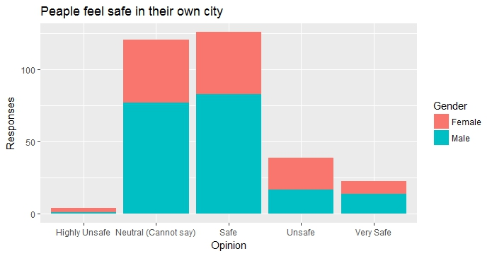
Do you feel safe in your own city?
Opinion | No of Res.
Very Safe | 23
Safe | 123
Neutral | 121
Unsafe | 39
Highly Unsafe | 4
Numbers of people find themselves safe in their City

